Slide 1


Slide 2
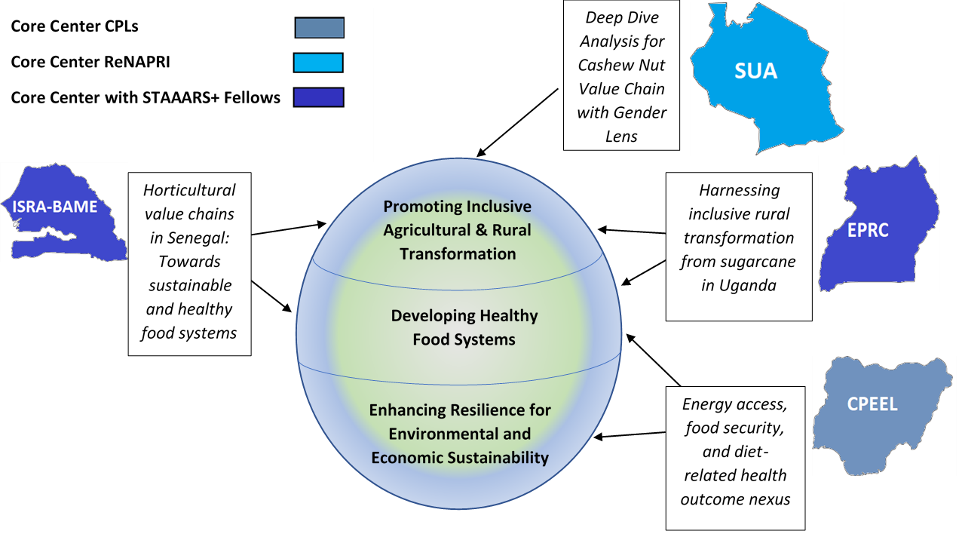
Research Conducted by Core Centers

Slide 3
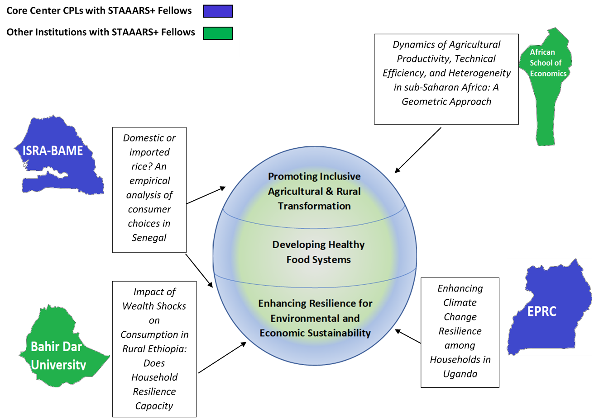
Research Conducted under STAAARS+

Slide 4


Towards sustainable and healthy food systems in Senegal
ISRA-BAME

Slide 5
Key Research Questions (1/2)
Overall question: How can horticulture value chains contribute to healthy and sustainable food systems in Senegal?
Related to (i) inclusive ag transformation and (ii) healthy food systems research themes
Farm segment
What are the determinants of:
  production (orientation, composition, level)?
  input demand ?
  marketed surplus rates?
  buyer choice?
What is the impact of crop marketing on farmer income?
Distribution segment (wholesale and retail)
What are the determinants of:
  urban wholesaler purchase and sale decisions in the modern, transitional, and traditional sectors and how do decisions differ between men and women?
  urban retailer purchase and sale decisions in the modern, transitional, and traditional sectors and how do decisions differ between men and women?

Slide 6
Key Research Questions (2/2)
Consumption segment
What are the patterns and determinants of fruit and vegetable consumption across income strata and city-type?
  What are the expenditure shares of fruits and vegetables?
  What is the composition of fruits and vegetables consumption?
  How diversified is the consumption of fruits and vegetables?
  How concentrated is the consumption of fruits and vegetables?
What are the determinants of fruit and vegetable consumption by supply sources (home production vs purchases)?
What are the determinants of fruit and vegetable prices?

Slide 7
Relevance to policymakers in Senegal
Local horticultural products account for over 2/3 of the country’s fruits and vegetables and thus, play a key role in achieving sustainable and healthy diets and food systems in Senegal.
Some horticultural crops, such as cherry tomatoes and melons are also exported, generating export revenue and employment.
This research will
  give insights on how taxes and/or subsidies on horticultural products can affect local consumption and production.
  provide empirical evidence on the best ways to develop the production and distribution segments of horticultural value chains in order to meet consumer preferences.

Slide 8
Methodology
This study relies on different cross-sectional surveys collected as part of the PAPA program in 2017-2018 in Senegal
  Farm segment
    1,305 farm households from the Niayes and Senegal River Valley and 1,381 farm households from the other (rainfed) areas of Senegal
  Distribution segment
    1,137 traders, including 112 wholesalers and 961 retailers
  Consumption segment
    2,250 urban households located in 19 major Senegalese cities and 4,680 rural households located in rural areas of Senegal
Descriptive analysis and several econometric models will be used

Slide 9
Methodology : Farm segment
Research questions | Dependent variables (LHS) | Explanatory variables (RHS)
What are the determinants of production orientation ? | Share of horticulture in total area | Prices Transaction costs Risk Farm and household characteristics Access to services Access to water Zone
What are the determinants of production composition ? | Adoption of diversified cropping system (1/0) Or degree of diversification (HHI)
What are the determinants of marketed surplus rate ? | Commercialization rate vs autoconsommation (vs losses)
What are the determinants of buyer choice? | Buyer (wholesaler vs. exporter, consumer)
What are the determinants of input demand (seeds and fertilizers)? | Usage (1/0), Quantity used (kg/ha), Amount invested (FCFA/ha) | Variables above + Output prices; input prices; quality of inputs
What are the determinants of production levels ? | Quantity produced (kg) | Land (ha); seed (kg); fertilizer (kg); household labor (number); hired labor (number)
What is the impact of crop marketing on farmer income? | Total farm revenue (sum of all revenues) | Risk Farm and household characteristics Access to services Access to water; zone

Slide 10
Methodology : Distribution segment
Research question | Dependent variables | Explanatory variables
What are the determinants of: urban wholesalers and retailers purchase and sale decisions in the modern, transitional, and traditional sectors and how do decisions differ between men and women? | Products purchased: diversification or specialization index | Product prices Transaction costs Type of town Season Risks Assets Gender Area Education
 | Type of product purchased
 | Type of supplier for the type of product purchased
 | Subscription to a contract in the purchase of products
 | Payment method (cash or credit) in the selling of products
 | Origin (import or local) in the purchase of products
 | Supplier of product purchased
 | Types of purchasers
What are the determinants of: urban wholesalers and retailers sale decisions in the modern, transitional, and traditional sectors and how do decisions differ between men and women? | Products sold: diversification or specialization index
 | The type of product sold: example industrial tomato vs. cherry tomato
 | Place of sale
 | Subscription to a contract in the sale of products
 | Payment method (cash or credit)
 | Origin (import or local) in the sale of products
 | Types of buyers in selling products

Slide 11
Methodology : Consumption segment
Research questions | Dependent variables | Explanatory variables
1. What are the patterns and determinants of fruit and vegetable (FV) consumption across income strata and city-type?
1.1. What are the expenditure shares of fruits and vegetables? | Expenditure share of FV last month | Price Household revenues Household size Farm household Dummy for rural or urban Dakar vs other towns FV producing vs non FV producing town Irrigated area vs non irrigated Education level of household head Sex of household head Number of women in the household Age of household head Index of sensitivity to certification
1.2. What is the composition of fruit and vegetable consumption? | Share of fruits in total FV consumption
 | Share of local onion/potato in total FV consumption
1.3. How diversified is FV consumption? | Simpson index
1.4. How concentrated is the consumption of fruits and vegetables? | Herfindahl index
2. What are the determinants of fruit and vegetable (FV) consumption by supply sources?
2.1. What are the determinant of home production of fruits and vegetables? | Share of home production in total consumption of FV | Above variables + perceptions on supply sources
2.2. What are the determinants of fruit and vegetable purchases? | Share of FV purchased from the market
 | Share of FV purchased from retail sellers in the neighborhood (who are predominantly women)
 | Share of FV purchased from supermarket

Slide 12
Planned Outputs and Outreach
Three research papers :
  The commercialization behavior and production choice in Senegalese horticultural farms
  Structure, conduct and performance of midstream segments of the horticulture value chain in Senegal
  The consumption of fruits and vegetables by consumer income strata and urban city-type (Dakar versus secondary cities and towns): patterns and determinants of consumption, and determinants of prices
Dissemination
  Seminars and/or webinars oriented toward key stakeholders
  Policy briefs

Slide 13

Harnessing inclusive rural transformation from Sugarcane growing in Uganda
Economic Policy Research Centre (EPRC)
Presented at the Virtual PRCI Global Launch Webinar
June 23, 2020

Slide 14
Background
Sugarcane is produced in all 4 regions of Uganda. By 2005 only 4 large-scale milling companies were operational. The main sources of cane are:
Nucleus estates
Outgrowers who are either;①register and aided by mills, ② registered but unaided;
By 2015 , more 14 small-scale mills joined (increasing competition for cane)
The increased expansion in sugar processing provides opportunities for inclusive rural transformation via: expanded off-farm employment; better access to agricultural services & infrastructure
Thus, making the study to contribute to PRCI theme of inclusive agricultural transformation
These largely source sugarcane from registered (un-aided) & independent growers
Independent growers

Slide 15
Background……..cont
The emerging challenge
①Large mills need access to a minimum amount of cane each year to minimize costs;
②Out-growers need a mill relatively close to them,
Harvested cane is both perishable and heavy
This implies that there is a tradeoff between the benefits of COORDINATION & COMPETITION
They need a minimum number of outgrowers to supply this cane
Both, outgrowers and mills need sound institutional arrangements to coordinate them for each to realize gains.
③Fewer mills can improve coordination, but can also reduce cane price competition
This is not good for growers

Slide 16
Why topic is relevant to policymakers
The President, on April 28, 2020, signed into law the Sugar Act 2020.
There are still areas of contention pertaining to licensing of sugar mills e.g.
Creation of an exclusion zone of a 25-kilometre radius.
Proponents of the act argue that:
Lack of zoning would affect the sugar industry by facilitating the small new factories to undermine the efforts of historical big players.
However, Opponents against the act argued that zoning would provide monopsony power and affect prices.
This study seeks to INFORM this debate
Argue for COORDINATION of sugar VC
A requirement that out growers in a particular radii supply cane to that mill.
Argue for COMPETITION

Slide 17
Key Research Questions
Q1) How do the different institutional arrangements between cane growers and processors function?
Q2) What are the determinants of farmer’s choice of outgrower scheme?
Q3) What are the outcomes of participating in different schemes in terms of productivity, profitability and food and nutrition security?
How do the costs and benefits of participation vary (e.g. by gender, wealth, location)?
What are the gendered roles, constraints, and opportunities within these different schemes?
What are the barriers to entry into the schemes?
Q4) What are the likely effects of covid-19 on the sugarcane VC in Uganda”
Note: Schemes are: aided/unaided registered, and independent growers
What is the potential for the schemes to contribute to sustainable and inclusive rural transformation?
Note: aided” farmers receive inputs on credit, technical assistance & Access to bank credit?

Slide 18
METHODOLOGY
Research Q1 & Q4
Identify evidence on different institutional arrangements governing sugarcane growing (e.g, coordination Vs competition)
Existing institutional arrangements along the sugar cane VC:-
Gendered division of labour & Access to and control over resources and services along the value chain;
Marketing arrangements (formal and informal)
Qualitative research (FGDs and KIIs) to gather information on:
Document and literature reviews to:
Understand how institutional arrangements are gender sensitive & provide more equitable opportunities
Contractual arrangements between mills & outgrowers;
Research Q2, Q3, & Q4
Empirical analysis:
A double-hurdle model to examine determinants of the choice to grow sugarcane and the intensity of production;
OLS and 2SLS – to examine the productivity and profitability effect of production arrangement and gender
Use Trade map- International Trade Centre (ITC) data to examine the effect of COVID-19 on sugar exports
Multinomial logit model - Determinants of choice of out-grower scheme

Slide 19
Data
Study Area:
Three major sugarcane production regions:
Secondary data
In-depth descriptive analysis based on the 2014 Uganda Population and Housing Census (UPHC).
National agricultural survey of 2018/19 (Note: Doesn’t include a food consumption module)
Primary data
Survey to collect HH data both growers and non-growers of sugar cane
The panel survey datasets by UBoS, (Note: there are less than 100 observations)
Key variables include: Sugar cane (Kgs), area in ha, production arrangement, profitability, gender land rights, roles, household decision making, and ownership of resources
FGDs and KIIs at community level and among other VC players
ITC trade secondary data
Eastern
Northern
Western

Slide 20
Planned Outputs and Outreach
Deliverables/outputs | Outreach/Title
Working paper | Harnessing inclusive rural transformation from Sugarcane growing in Uganda
Policy brief(s) | Gender & decision-making in sugarcane growing in Uganda Institutions & commercial sugarcane growing and food security in Uganda
Stakeholder consultative workshops | 2 Regional Stakeholder consultations to review and validate study results. [Targeting ; civil society, private sector, local leaders, outgrowers, millers]
Top Policy meetings | Three (3) Targeted meetings with top policy makers in key ministries (MAAIF MOFPED and MTIC)
Parliamentary briefing | One (1) Targeted Meeting with sessional committees of parliament- The parliamentary committee on Agriculture and Sectoral Committee on Tourism, Trade and Industry
Dissemination Workshop | Ensuring Sustainable Development of Uganda’s Sugar industry
2 opinion articles placed in the media | Two (2) opinion articles placed in the media Press briefing on study findings
As opportunities & need arises | Participation in Talk shows either radio or TV to share study findings

Slide 21




Analysis of Tanzania Cashew Nut
Value Chain with Gender Lens
PRCI Global Lab Launch Webinar, 23 June 2020
                Venance Mpunde, Aika Aku
School of Agricultural Economics and Business Studies (SAEBS)
Sokoine University of Agriculture (SUA)

Slide 22
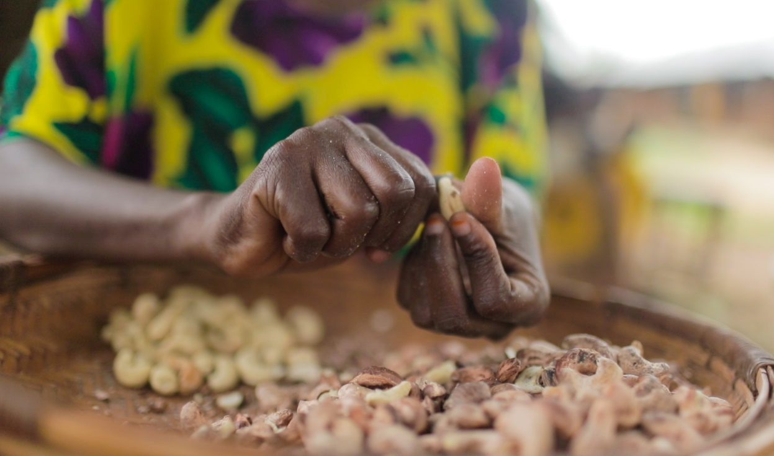
Key Research Questions
What is the role of women in the cashew value chain (VC) in Tanzania? What opportunities and constraints exist for increasing inclusivity and women’s empowerment along the cashew VC?
    1.1. Cashew production
    1.2. Cashew nut marketing
    1.3. Cashew nut processing

Slide 23
Key Research Questions
How effective have on-going government interventions been in increasing productivity, profitability and inclusion of women in cashew VC?
How has COVID-19 affected the cashew VC?
  Are there gender differences in the way these effects are experienced?
  Does COVID-19 have different effects on domestic and international market channels?

Slide 24
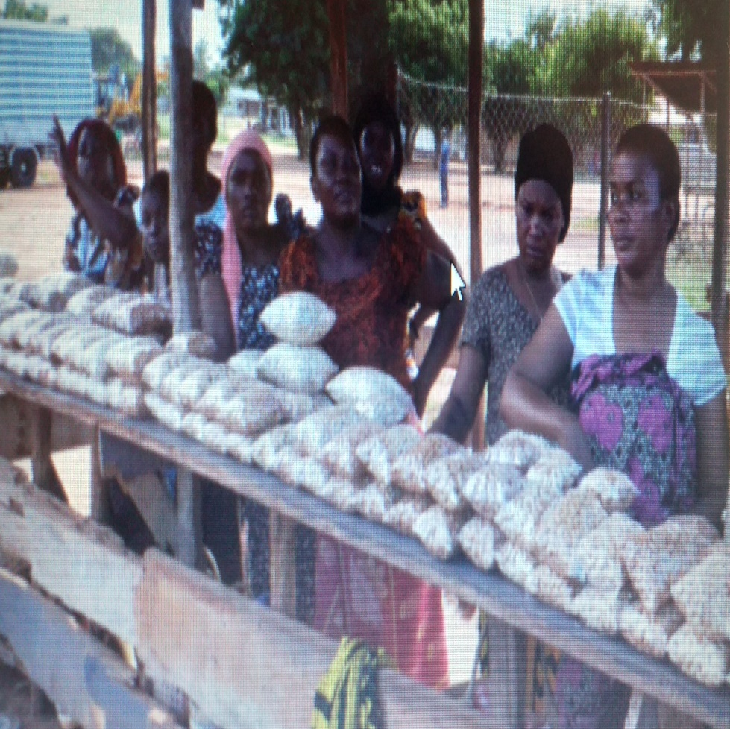
Policy relevance for Tanzania
On-going government initiatives
  Policy and strategy (NGDP in 2005; National Strategy for Gender Development -2009)
  National implementation agencies e.g. NEEC (coordinates > 12 funds); TGNP (advocacy); Hakiaridhi (Land equity)
  Cashew VC is prioritized in ASDP II
  Some city councils support women in processing
All these have implementation challenges such as
  Prioritization on government funded programs/projects
  Limitation in accessing the services (located in towns; limited knowledge of available services)

Slide 25
Methodology: Hypotheses
Unequal role of women in intra-household decision-making regarding cashew income
Quality of women’s cashew typically not high enough for export market
Government interventions have minimal success to date
No effect of COVID-19 on the cashew VC

Slide 26
Methodology
Use both qualitative and quantitative information to address questions like:
What roles do women play in each node of the cashew Value Chain
What are the constraints and opportunities for women’s empowerment at each node of the Value Chain
Use FGD and KIIs guided by the Women Empowerment in Agriculture Index for Value Chains (WEAI4VC) for development of questions

Slide 27
Methodology
DATA -- plot-level household survey data from Tanzania National Panel Survey (2008/09, 2010/11; 2012/14)
OLS regression of -- Dependent variable = Raw cashew nut yield (kg/acre)
Independent variables
Dummy variable = 1 if plot production decisions made jointly (male & female); Separate dummy = 1 if plot production decisions made by female head alone
Prices (Raw cashew purchase price; village farm wage; village pesticide price)
Market access (Distance from nearest large-scale processors (separately for small-scale); HH ownership of vehicle, motorcycle, bicycle, cart
Membership in farmer marketing coop (AMCOS)
Household demographics, household farm assets (land, livestock, etc), other

Slide 28
Planned Outputs and Outreach
Outputs
Working paper / Journal article / Policy brief
Outreach
Workshops with local stakeholders
  government, private sector, producers, vendors, processors, etc.
Workshops with Local policymakers
  government, donors, academia, etc; including the Annual Agricultural Policy Conference organized by PAG

Slide 29
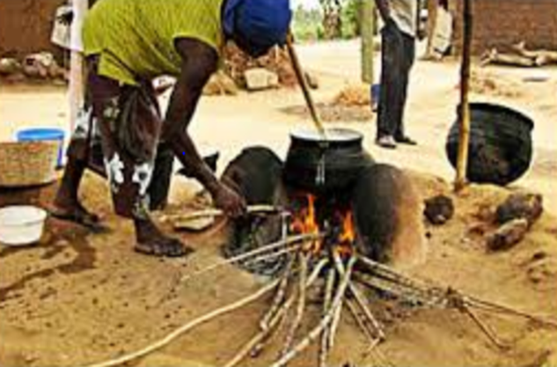


The Energy Poverty & Food Security Nexus in Nigeria
By
Centre for Petroleum, Energy Economics and Law (CPEEL), University of Ibadan, Nigeria
@
PRCI Global Lab Launch Webinar June 23, 2020
Olufunke Alaba, Adeola Adenikinju, Adegbenga Adekoya, Temilade Sesan, Oluwatosin Adeniyi, Iredele Ogunbayo, Nkechinyelu Oranye, Oluwaseun Oyeranti, Cecilia Faluyi

Slide 30

Background
Energy poverty = Inadequate, unaffordable, unreliable, and lack of environmentally benign energy services to support economic and human development. (Reddy, 2000)
Only 8% of Nigerians had access to a clean cooking energy source between 2014 & 2018. (WHO, 2018)
Nigeria’s Twin Problems
Energy Poverty
Food Insecurity
Energy Poverty
Dependence on traditional fuels (firewood, crop residues, etc.)
Food Insecurity
Energy expenditure %=high
Lack of food, access and its entitlement
(Sen, 1981)
Lack of access to land assets & conflict and job (FAO et al., 2014)
Lack of access to clean energy
(FAO, 1990; Stephy et al., 2013)

Slide 31


Background
4 Pillars of Food Security –
Availability
Access
Stability
Utilization
Identified links by Sola et. al. (2016)
Energy Access
Food Security
Health Outcomes
CPEEL 2017 Workshop Communities shared their lived experiences on the relationship among fuel costs, energy choices and nutrition outcomes.
Notes:
GNAFC – Global Network Against Food Crisis
The last revision of the definition of food security happened at the 2009 world summit on food security which added a fourth dimension - Stability

Slide 32
Key Research Questions
Focus on energy poverty & effects on food security
Aligns with 2nd and 3rd themes of PRCI’s overarching objectives- environmental sustainability, food safety and health status
Research questions:
  What is the difference in food security, dietary profile and energy access of households in Nigeria by geo-political zones, rural/urban?
  Are there changes over time and by gender in food security, energy access and household dietary intake outcomes?
  Is there a relationship between cooking fuel expenditure and food security?
  Does energy poverty, food security and nutrition affect men and women differently?

Slide 33
Relevance to Policymakers in Nigeria
SDG 1 (No Hunger), 2 (Zero poverty), 5 (Gender Equality) & 7 (Affordable and Clean Energy)
Past Development Plans ignored the importance of energy access in addressing food security and agricultural and rural transformation
Inadequate consideration of gender dimension
Historically, food security and energy access reforms in Nigeria have been isolated from one another
Opens up an often-ignored link between energy access and food security outcomes. Findings will enable policymakers to make informed policies based on evidence

Slide 34
Hypotheses & Data
Hypotheses of the Study:
  H_{A}: significant relationship between cooking fuel expenditure and food security
  H_{A}: significant relationship between food insecurity and energy poverty by gender
This study utilizes the Nigeria LSMS-ISA four-wave household panel survey dataset:- (2010/2011, 2012/2013, 2015/2016 and 2018/2019)
Qualitative data - this is still under consideration

Slide 35
Methodology
Econometric Methods
  Panel Data Methods (Fixed and Random Effects)
  Instrumental Variable
Outcome Variables | Explanatory Variables
Calorie Intake Dietary Diversity Subjective Food (In)Security Measure- based on experience and perception | Expenditure on Fuel disaggregated by energy source Use of clean cooking energy vs traditional fuels Household demographic structure Educational status Assets ownership

Slide 36
Planned Outputs and Outreach
Hypothesized link between energy access, fuel choices and food security if confirmed:
Argue stronger policy support for promoting access to modern energy for poor households
Medium Term National Development Plan (2021-2025) and Agenda 2050
Contributes to the Literature & Agricultural and Food Security Policy
  Journal Articles
  Policy Briefs
  Workshops
Recommendations disseminated directly to the communities involved with CPEEL
Stakeholders
  Civil Societies, Local Communities, Federal & State Ministries of Agriculture, Women Affairs & Social Development, Health, Planning & National Development, Rural Electrification Agency, Energy Commission

Slide 37

Q & A

